Slide 1
The Art and Practice of Planning and Projecting Ideas with Visual and Textual Content
Travis Moore | UX/UI Designer
thedevilswaffle@gmail.com
www.thedevilswaffle.com
COL 499 Fall 2016
Professor: Mojan Ahmadi

Slide 2
— or —
Travis Moore | UX/UI Designer
thedevilswaffle@gmail.com
www.thedevilswaffle.com
COL 499 Fall 2016
Professor: Mojan Ahmadi

Slide 3
Graphic Design
Travis Moore | UX/UI Designer
thedevilswaffle@gmail.com
www.thedevilswaffle.com
COL 499 Fall 2016
Professor: Mojan Ahmadi

Slide 4
Graphic Design
(as it pertains to your logo)
Travis Moore | UX/UI Designer
thedevilswaffle@gmail.com
www.thedevilswaffle.com
COL 499 Fall 2016
Professor: Mojan Ahmadi

Slide 5
Why have a logo?

Slide 6
Why have a logo?
A logo identifies you and helps you stand out

Slide 7
Why have a logo?
A logo identifies you and helps you stand out
A logo is a first impression that derives meaning from what it identifies

Slide 8
Why have a logo?
A logo identifies you and helps you stand out
A logo is a first impression that derives meaning from what it identifies
(in this case, you)

Slide 9
And if that doesn’t convince you

Slide 10

>
Myrkott Animation Studio
MYRKOTT ANIMATION STUDIO

Slide 11
Okay, sure. I’ll make a logo.

Slide 12
AWESOME!

Slide 13
AWESOME!
Here’s some things to keep in mind…

Slide 14
Keep it Simple

Slide 15
Keep it Simple
Logos are made to be simple

Slide 16

Keep it Simple
Why does Apple’s logo work?

Slide 17
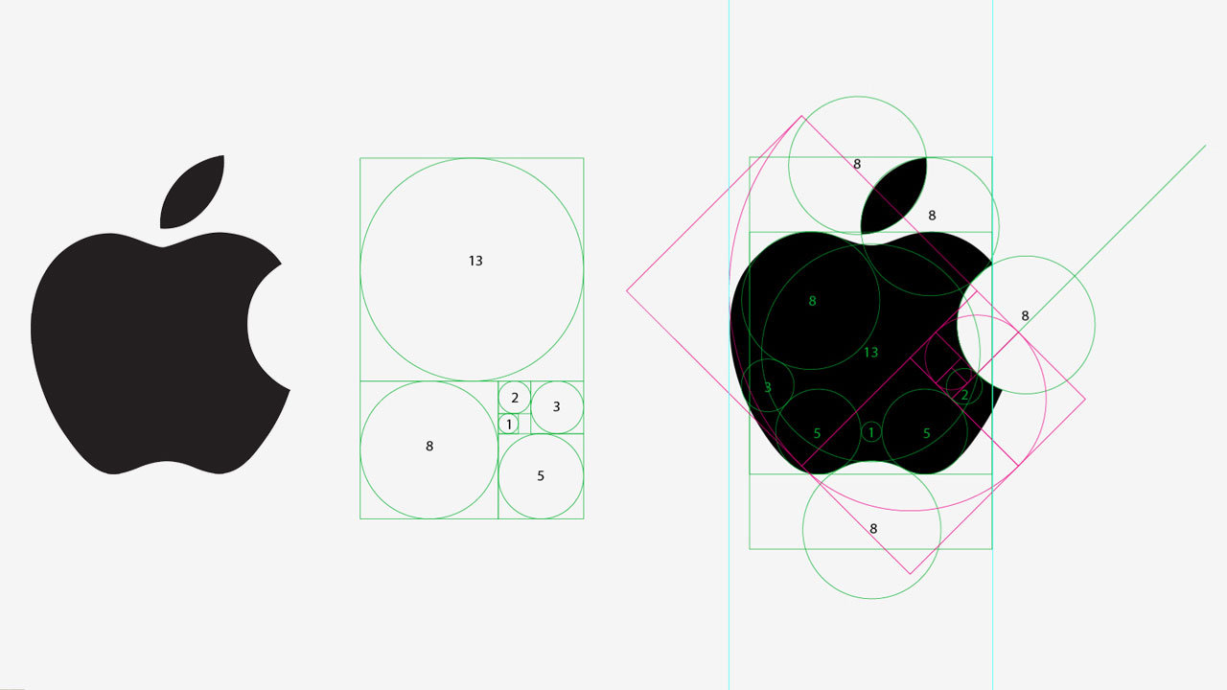

Keep it Simple
Why does Apple’s logo work?

Slide 18
Keep it Simple
Simple shapes keep the logo obvious to the viewer’s eye

Slide 19
Keep it Simple
Simple shapes keep the logo obvious to the viewer’s eye
MYRKOTT ANIMATION STUDIO

Slide 20
Alright, what else?

Slide 21
Make it Memorable

Slide 22
Make it Memorable
So how do we know our logo is memorable?

Slide 23
Make it Memorable
So how do we know our logo is memorable?
TEST IT!

Slide 24
TEST TIME

Slide 25
TEST TIME
Everyone take out some paper and a pencil

Slide 26


TEST TIME

Slide 27
TEST TIME
You have 30 seconds.
Draw both logos.

Slide 28
TEST TIME
Times up!

Slide 29
TEST TIME
How’d you do?

Slide 30
Make it Memorable
Making it memorable ties in nicely with keeping it simple

Slide 31

A Quick Aside…
Natural progression towards simplicity!

Slide 32
Anything else?

Slide 33
Give it Meaning

Slide 34
Give it Meaning
Seems obvious, but it can be overlooked for the sake of making it “look cool”

Slide 35

Give it Meaning
What is this?

Slide 36
Give it Meaning
Is this what a trailblazer looks like?

Slide 37

Give it Meaning
While not flashy, the FedEx logo has depth

Slide 38
What have we learned?

Slide 39
Why Have A Logo?
Logos are how you identify yourself, your brand
KEEP IT SIMPLE MAKE IT MEMORABLE GIVE IT MEANING

Slide 40
THANK YOU!
Travis Moore | UX/UI Designer
thedevilswaffle@gmail.com
www.thedevilswaffle.com
COL 499 Fall 2016
Professor: Mojan Ahmadi

